Slide 1
Project Progress Report
DOT Traffic Ops database migration project
Jason Wu, Hyunsoo Lee

Slide 2
Background, Goals, Objectives
Background: The current database that NYC DOT Traffic Ops is using to store relevant information on crossing signals is slow to respond to input, takes up excessive and redundant storage, is user unfriendly, and requires dedicated maintenance.
This project intends to resolve this problem by creating a new database and User Interface that will replace the existing database and UI and port over all existing data.

Slide 3
Updates
We have implemented functionality for displaying portions of or the entirety of the database. The user can toggle between different subsets of the database to be shown via various buttons.
Screenshot for this is in the next slide.

Slide 4
Screenshots

Slide 5
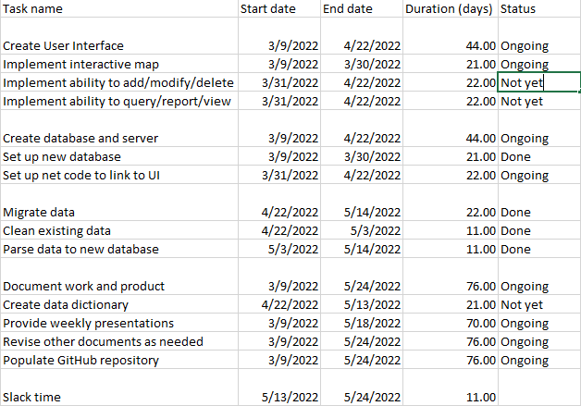
Current work breakdown

Slide 6
Questions, contact
Contact info (Jason Wu):
(347)274-4302, zehong.wu@macaulay.cuny.edu
Contact info (Hyunsoo Lee):
hsleenet@gmail.com

Slide 7
Communication Plan
Name | Title | Frequency | Format, Channel | Notes
Maddalena Romano | Sponsor, Stakeholder | Weekly | Presentations via Zoom, other issues via email
Bill Harrison | Stakeholder | Asynchronous | Presentations via Zoom if present, other issues via email as needed
Type | Method | Frequency | Goal | Owner | Audience
Progress Report | Presentation via Zoom | Weekly, every Wednesday | Inform audience of the state of the project as of each report | Project Managers | Stakeholders, Customers

Slide 8
Process
We are currently in the first section (front and back ends).
User Interface
Database and server
Ensure functional UI
Ensure responsive database
Clean data from old database
Parse data to new database
Front and back ends
Testing
Data migration

